Slide 1
Bayesian Knowledge Tracing Prediction Models

Slide 2
Bayesian Knowledge Tracing

Slide 3
Goal
Infer the latent construct
Does a student know skill X

Slide 4
Goal
Infer the latent construct
Does a student know skill X
From their pattern of correct and incorrect responses on problems or problem steps involving skill X

Slide 5
Enabling
Prediction of future correctness within the educational software
Prediction of future correctness outside the educational software
e.g. on a post-test

Slide 6
Assumptions
Student behavior can be assessed as correct or not correct
Each problem step/problem is associated with one skill/knowledge component

Slide 7
Assumptions
Student behavior can be assessed as correct or not correct
Each problem step/problem is associated with one skill/knowledge component
And this mapping is defined reasonably accurately

Slide 8
Assumptions
Student behavior can be assessed as correct or not correct
Each problem step/problem is associated with one skill/knowledge component
And this mapping is defined reasonably accurately (though extensions such as Contextual Guess and Slip may be robust to violation of this constraint)

Slide 9
Multiple skills on one step
There are alternate approaches which can handle this (cf. Conati, Gertner, & VanLehn, 2002; Ayers & Junker, 2006; Pardos, Beck, Ruiz, & Heffernan, 2008)
Bayesian Knowledge-Tracing is simpler (and should produce comparable performance) when there is one primary skill per step

Slide 10
Bayesian Knowledge Tracing
Goal: For each knowledge component (KC), infer the student’s knowledge state from performance.
Suppose a student has six opportunities to apply a KC and makes the following sequence of correct (1) and incorrect (0) responses. Has the student has learned the rule?
0 0 1 0 1 1

Slide 11
Model Learning Assumptions
Two-state learning model
Each skill is either learned or unlearned
In problem-solving, the student can learn a skill at each opportunity to apply the skill
A student does not forget a skill, once he or she knows it
Studied in Pavlik’s models
Only one skill per action

Slide 12
Addressing Noise and Error
If the student knows a skill, there is still some chance the student will slip and make a mistake.
If the student does not know a skill, there is still some chance the student will guess correctly.

Slide 13
Corbett and Anderson’s Model
Not learned
p(T)
Learned
p(L₀)
p(G)
1-p(S)
correct
correct
Two Learning Parameters
p(L₀) Probability the skill is already known before the first opportunity to use the skill in problem solving.
p(T) Probability the skill will be learned at each opportunity to use the skill.
Two Performance Parameters
p(G) Probability the student will guess correctly if the skill is not known.
p(S) Probability the student will slip (make a mistake) if the skill is known.

Slide 14
Bayesian Knowledge Tracing
Whenever the student has an opportunity to use a skill, the probability that the student knows the skill is updated using formulas derived from Bayes’ Theorem.

Slide 15


Formulas

Slide 16
Questions? Comments?

Slide 17
Knowledge Tracing
How do we know if a knowledge tracing model is any good?
Our primary goal is to predict knowledge

Slide 18
Knowledge Tracing
How do we know if a knowledge tracing model is any good?
Our primary goal is to predict knowledge
But knowledge is a latent trait

Slide 19
Knowledge Tracing
How do we know if a knowledge tracing model is any good?
Our primary goal is to predict knowledge
But knowledge is a latent trait
We can check our knowledge predictions by checking how well the model predicts performance

Slide 20
Fitting a Knowledge-Tracing Model
In principle, any set of four parameters can be used by knowledge-tracing
But parameters that predict student performance better are preferred

Slide 21
Knowledge Tracing
So, we pick the knowledge tracing parameters that best predict performance
Defined as whether a student’s action will be correct or wrong at a given time
Effectively a classifier (which we’ll talk about in a few minutes)

Slide 22
Questions? Comments?

Slide 23
Recent Extensions
Recently, there has been work towards contextualizing the guess and slip parameters (Baker, Corbett, & Aleven, 2008a, 2008b)
Do we really think the chance that an incorrect response was a slip is equal when
Student has never gotten action right; spends 78 seconds thinking; answers; gets it wrong
Student has gotten action right 3 times in a row; spends 1.2 seconds thinking; answers; gets it wrong

Slide 24
The jury’s still out…
Initial reports showed that CG BKT predicted performance in the tutor much better than existing approaches to fitting BKT (Baker, Corbett, & Aleven, 2008a, 2008b)
But a new “brute force” approach, which tries all possible parameter values for the 4-parameter model performs equally well as CG BKT (Baker, Corbett, Gowda, 2010)

Slide 25
The jury’s still out…
CG BKT predicts post-test performance worse than existing approaches to fitting BKT (Baker, Corbett, Gowda, et al, 2010)
But P(S) predicts post-test above and beyond BKT (Baker, Corbett, Gowda, et al, 2010)
So there is some way that contextual G and S are useful – we just don’t know what it is yet

Slide 26
Questions? Comments?

Slide 27
Fitting BKT models
Bayes Net Toolkit – Student Modeling
Expectation Maximization
http://www.cs.cmu.edu/~listen/BNT-SM/
Java Code
Grid Search/Brute Force
http://users.wpi.edu/~rsbaker/edmtools.html
Conflicting results as to which is best

Slide 28
Identifiability
Different models can achieve the same predictive power
(Beck & Chang, 2007; Pardos et al, 2010)

Slide 29
Model Degeneracy
Some model parameter values, typically where P(S) or P(G) is greater than 0.5
Infer that knowledge leads to poorer performance
(Baker, Corbett, & Aleven, 2008)

Slide 30
Bounding
Corbett & Anderson (1995) bounded P(S) and P(G) to maximum values below 0.5 to avoid this
P(S)<0.1
P(G)<0.3
Fancier approaches have not yet solved this problem in a way that clearly avoids model degeneracy

Slide 31
Uses of Knowledge Tracing
Often key components in models of other constructs
Help-Seeking and Metacognition (Aleven et al, 2004, 2008)
Gaming the System (Baker et al, 2004, 2008)
Off-Task Behavior (Baker, 2007)

Slide 32
Uses of Knowledge Tracing
If you want to understand a student’s strategic/meta-cognitive choices, it is helpful to know whether the student knew the skill
Gaming the system means something different if a student already knows the step, versus if the student doesn’t know it
A student who doesn’t know a skill should ask for help; a student who does, shouldn’t

Slide 33
Cognitive Mastery
One way that Bayesian Knowledge Tracing is frequently used is to drive Cognitive Mastery Learning (Corbett & Anderson, 2001)
Essentially, a student is given more practice on a skill until P(Ln)>=0.95
Note that other skills are often interspersed

Slide 34
Cognitive Mastery
Leads to comparable learning in less time
“Over-practice” – continuing after mastery has been reached – does not lead to better post-test performance (cf. Cen, Koedinger, & Junker, 2006)
Though it may lead to greater speed and fluency (Pavlik et al, 2008)

Slide 35
Questions? Comments?

Slide 36
Prediction: Classification and Regression

Slide 37
Prediction
Pretty much what it says
A student is using a tutor right now. Is he gaming the system or not?
A student has used the tutor for the last half hour.
How likely is it that she knows the skill in the next step?
A student has completed three years of high school.
What will be her score on the college entrance exam?

Slide 38
Classification
General Idea
Canonical Methods
Assessment
Ways to do assessment wrong

Slide 39
Classification
There is something you want to predict (“the label”)
The thing you want to predict is categorical
The answer is one of a set of categories, not a number
CORRECT/WRONG (sometimes expressed as 0,1)
HELP REQUEST/WORKED EXAMPLE REQUEST/ATTEMPT TO SOLVE
WILL DROP OUT/WON’T DROP OUT
WILL SELECT PROBLEM A,B,C,D,E,F, or G

Slide 40
Classification
Associated with each label are a set of “features”, which maybe you can use to predict the label
Skill pknow time totalactions right
ENTERINGGIVEN 0.704 9 1 WRONG
ENTERINGGIVEN 0.502 10 2 RIGHT
USEDIFFNUM 0.049 6 1 WRONG
ENTERINGGIVEN 0.967 7 3 RIGHT
REMOVECOEFF 0.792 16 1 WRONG
REMOVECOEFF 0.792 13 2 RIGHT
USEDIFFNUM 0.073 5 2 RIGHT
….

Slide 41
Classification
The basic idea of a classifier is to determine which features, in which combination, can predict the label
Skill pknow time totalactions right
ENTERINGGIVEN 0.704 9 1 WRONG
ENTERINGGIVEN 0.502 10 2 RIGHT
USEDIFFNUM 0.049 6 1 WRONG
ENTERINGGIVEN 0.967 7 3 RIGHT
REMOVECOEFF 0.792 16 1 WRONG
REMOVECOEFF 0.792 13 2 RIGHT
USEDIFFNUM 0.073 5 2 RIGHT
….

Slide 42
Classification
One way to classify is with a Decision Tree (like J48)
PKNOW
<0.5
>=0.5
TIME
TOTALACTIONS
<6s.
>=6s.
<4
>=4
RIGHT
WRONG
RIGHT
WRONG

Slide 43
Classification
One way to classify is with a Decision Tree (like J48)
PKNOW
<0.5
>=0.5
TIME
TOTALACTIONS
<6s.
>=6s.
<4
>=4
RIGHT
WRONG
RIGHT
WRONG
Skill pknow time totalactions right
COMPUTESLOPE 0.544 9 1 ?

Slide 44
Classification
Another way to classify is with step regression
(used in Cetintas et al, 2009; Baker, Mitrovic, & Mathews, 2010)
Linear regression (discussed later), with a cut-off

Slide 45
And of course…
There are lots of other classification algorithms you can use...
SMO (support vector machine)
In your favorite Machine Learning package

Slide 46
How can you tell if a classifier is any good?

Slide 47
How can you tell if a classifier is any good?
What about accuracy?
# correct classifications
total number of classifications
9200 actions were classified correctly, out of 10000 actions = 92% accuracy, and we declare victory.

Slide 48
How can you tell if a classifier is any good?
What about accuracy?
# correct classifications
total number of classifications
9200 actions were classified correctly, out of 10000 actions = 92% accuracy, and we declare victory.
Any issues?

Slide 49
Non-even assignment to categories
Percent Agreement does poorly when there is non-even assignment to categories
Which is almost always the case
Imagine an extreme case
Uniqua (correctly) picks category A 92% of the time
Tasha always picks category A
Agreement/accuracy of 92%
But essentially no information

Slide 50
What are some alternate metrics you could use?

Slide 51
What are some alternate metrics you could use?
Kappa
(Accuracy – Expected Accuracy)
(1 – Expected Accuracy)
Notes:
HERE!

Slide 52
What are some alternate metrics you could use?
A’ (Hanley & McNeil, 1982)
The probability that if the model is given an example from each category, it will accurately identify which is which

Slide 53
Comparison
Kappa
easier to compute
works for an unlimited number of categories
wacky behavior when things are worse than chance
difficult to compare two kappas in different data sets (K=0.6 is not always better than K=0.5)

Slide 54
Comparison
A’
more difficult to compute
only works for two categories (without complicated extensions)
meaning is invariant across data sets (A’=0.6 is always better than A’=0.55)
very easy to interpret statistically

Slide 55
Comments? Questions?

Slide 56
What data set should you generally test on?
A vote…
Raise your hands as many times as you like

Slide 57
What data set should you generally test on?
The data set you trained your classifier on
A data set from a different tutor
Split your data set in half (by students), train on one half, test on the other half
Split your data set in ten (by actions). Train on each set of 9 sets, test on the tenth. Do this ten times.
Votes?

Slide 58
What data set should you generally test on?
The data set you trained your classifier on
A data set from a different tutor
Split your data set in half (by students), train on one half, test on the other half
Split your data set in ten (by actions). Train on each set of 9 sets, test on the tenth. Do this ten times.
What are the benefits and drawbacks of each?

Slide 59
The dangerous one
The data set you trained your classifier on
If you do this, there is serious danger of over-fitting
Only acceptable in rare situations

Slide 60
The dangerous one
You have ten thousand data points.
You fit a parameter for each data point.
“If data point 1, RIGHT. If data point 78, WRONG…”
Your accuracy is 100%
Your kappa is 1
Your model will neither work on new data, nor will it tell you anything.

Slide 61
K-fold cross validation (standard)
Split your data set in ten (by action). Train on each set of 9 sets, test on the tenth. Do this ten times.
What can you infer from this?

Slide 62
K-fold cross validation (standard)
Split your data set in ten (by action). Train on each set of 9 sets, test on the tenth. Do this ten times.
What can you infer from this?
Your detector will work with new data from the same students

Slide 63
K-fold cross validation (standard)
Split your data set in ten (by action). Train on each set of 9 sets, test on the tenth. Do this ten times.
What can you infer from this?
Your detector will work with new data from the same students
How often do we really care about this?

Slide 64
K-fold cross validation (student-level)
Split your data set in half (by student), train on one half, test on the other half
What can you infer from this?

Slide 65
K-fold cross validation (student-level)
Split your data set in half (by student), train on one half, test on the other half
What can you infer from this?
Your detector will work with data from new students from the same population (whatever it was)
Possible to do in RapidMiner
Not possible to do in Weka GUI

Slide 66
A data set from a different tutor
The most stringent test
When your model succeeds at this test, you know you have a good/general model
When it fails, it’s sometimes hard to know why

Slide 67
An interesting alternative
Leave-out-one-tutor-cross-validation (cf. Baker, Corbett, & Koedinger, 2006)
Train on data from 3 or more tutors
Test on data from a different tutor
(Repeat for all possible combinations)
Good for giving a picture of how well your model will perform in new lessons

Slide 68
Comments? Questions?

Slide 69
Statistical testing

Slide 70
Statistical testing
Let’s say you have a classifier A. It gets kappa = 0.3. Is it actually better than chance?
Let’s say you have two classifiers, A and B. A gets kappa = 0.3. B gets kappa = 0.4. Is B actually better than A?

Slide 71
Statistical tests
Kappa can generally be converted to a chi-squared test
Just plug in the same table you used to compute kappa, into a statistical package
Or I have an Excel spreadsheet I can share w/ you
A’ can generally be converted to a Z test
I also have an Excel spreadsheet for this (or see Fogarty, Baker, & Hudson, 2005)

Slide 72
A quick example
Let’s say you have a classifier A. It gets kappa = 0.3. Is it actually better than chance?
10,000 data points from 50 students

Slide 73
Example
Kappa -> Chi-squared test
You plug in your 10,000 cases, and you get
Chi-sq(1,df=10,000)=3.84, two-tailed p=0.05
Time to declare victory?

Slide 74
Example
Kappa -> Chi-squared test
You plug in your 10,000 cases, and you get
Chi-sq(1,df=10,000)=3.84, two-tailed p=0.05
No, I did something wrong here

Slide 75
Non-independence of the data
If you have 50 students
It is a violation of the statistical assumptions of the test to act like their 10,000 actions are independent from one another
For student A, action 6 and 7 are not independent from one another (actions 6 and 48 aren’t independent either)
Why does this matter?
Because treating the actions like they are independent is likely to make differences seem more statistically significant than they are

Slide 76
So what can you do?

Slide 77
So what can you do?
Compute statistical significance test for each student, and then use meta-analysis statistical techniques to aggregate across students
(hard to do but does not violate any statistical assumptions)
I have java code which does this for A’, which I’m glad to share with whoever would like to use this later

Slide 78
Comments? Questions?

Slide 79
Hands-on Activity
At 11:45…

Slide 80
Regression

Slide 81
Regression
There is something you want to predict (“the label”)
The thing you want to predict is numerical
Number of hints student requests
How long student takes to answer
What will the student’s test score be

Slide 82
Regression
Associated with each label are a set of “features”, which maybe you can use to predict the label
Skill pknow time totalactions numhints
ENTERINGGIVEN 0.704 9 1 0
ENTERINGGIVEN 0.502 10 2 0
USEDIFFNUM 0.049 6 1 3
ENTERINGGIVEN 0.967 7 3 0
REMOVECOEFF 0.792 16 1 1
REMOVECOEFF 0.792 13 2 0
USEDIFFNUM 0.073 5 2 0
….

Slide 83
Regression
The basic idea of regression is to determine which features, in which combination, can predict the label’s value
Skill pknow time totalactions numhints
ENTERINGGIVEN 0.704 9 1 0
ENTERINGGIVEN 0.502 10 2 0
USEDIFFNUM 0.049 6 1 3
ENTERINGGIVEN 0.967 7 3 0
REMOVECOEFF 0.792 16 1 1
REMOVECOEFF 0.792 13 2 0
USEDIFFNUM 0.073 5 2 0
….

Slide 84
Linear Regression
The most classic form of regression is linear regression
Alternatives include Poisson regression, Neural Networks...

Slide 85
Linear Regression
The most classic form of regression is linear regression
Numhints = 0.12*Pknow + 0.932*Time – 0.11*Totalactions
Skill pknow time totalactions numhints
COMPUTESLOPE 0.544 9 1 ?

Slide 86
Linear Regression
Linear regression only fits linear functions (except when you apply transforms to the input variables, which RapidMiner can do for you…)

Slide 87
Linear Regression
However…
It is blazing fast
It is often more accurate than more complex models, particularly once you cross-validate
Data Mining’s “Dirty Little Secret”
It is feasible to understand your model (with the caveat that the second feature in your model is in the context of the first feature, and so on)

Slide 88
Example of Caveat
Let’s study a classic example

Slide 89
Example of Caveat
Let’s study a classic example
Drinking too much prune nog at a party, and having to make an emergency trip to the Little Researcher’s Room

Slide 90
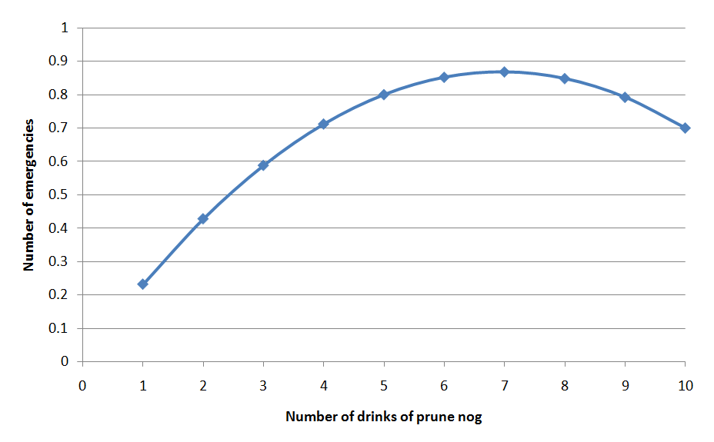
Data

Slide 91
Data
Some people are resistent to the deletrious effects of prunes and can safely enjoy high quantities of prune nog!

Slide 92
Learned Function
Probability of “emergency”= 0.25 * # Drinks of nog last 3 hours - 0.018 * (Drinks of nog last 3 hours)²
But does that actually mean that (Drinks of nog last 3 hours)² is associated with less “emergencies”?

Slide 93
Learned Function
Probability of “emergency”= 0.25 * # Drinks of nog last 3 hours - 0.018 * (Drinks of nog last 3 hours)²
But does that actually mean that (Drinks of nog last 3 hours)² is associated with less “emergencies”?
No!

Slide 94
Example of Caveat
(Drinks of nog last 3 hours)² is actually positively correlated with emergencies!
r=0.59

Slide 95
Example of Caveat
The relationship is only in the negative direction when (Drinks of nog last 3 hours) is already in the model…

Slide 96
Example of Caveat
So be careful when interpreting linear regression models (or almost any other type of model)

Slide 97
Comments? Questions?

Slide 98
Neural Networks
Another popular form of regression is neural networks (also called Multilayer Perceptron)
This image courtesy of Andrew W. Moore, Google http://www.cs.cmu.edu/~awm/tutorials

Slide 99
Neural Networks
Neural networks can fit more complex functions than linear regression
It is usually near-to-impossible to understand what the heck is going on inside one

Slide 100
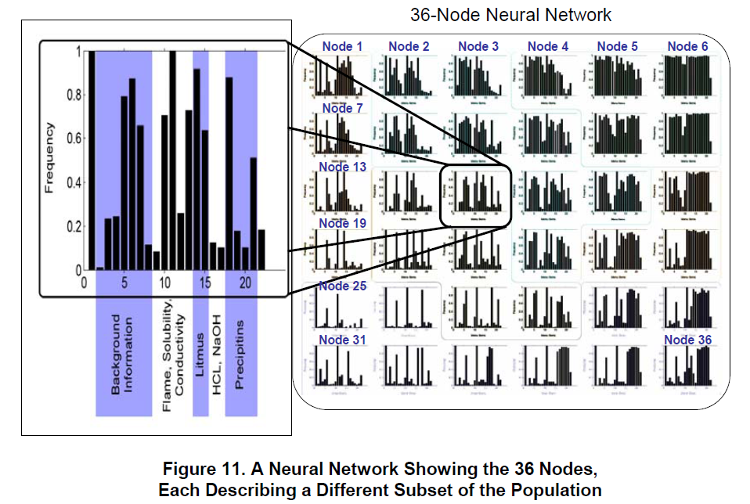
Soller & Stevens (2007)

Slide 101
In fact
The difficulty of interpreting non-linear models is so well known, that New York City put up a road sign about it

Slide 102
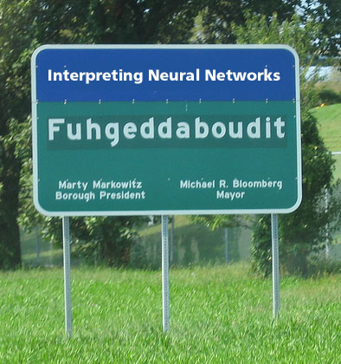

Slide 103
And of course…
There are lots of fancy regressors in any Data Mining package
SMOReg (support vector machine)
Poisson Regression
And so on

Slide 104
How can you tell if a regression model is any good?

Slide 105
How can you tell if a regression model is any good?
Correlation is a classic method
(Or its cousin r²)

Slide 106
What data set should you generally test on?
The data set you trained your classifier on
A data set from a different tutor
Split your data set in half, train on one half, test on the other half
Split your data set in ten. Train on each set of 9 sets, test on the tenth. Do this ten times.
Any differences from classifiers?

Slide 107
What are some stat tests you could use?

Slide 108
What about?
Take the correlation between your prediction and your label
Run an F test
So F(1,9998)=50.00, p<0.00000000001

Slide 109
What about?
Take the correlation between your prediction and your label
Run an F test
So F(1,9998)=50.00, p<0.00000000001
All cool, right?

Slide 110
As before…
You want to make sure to account for the non-independence between students when you test significance
An F test is fine, just include a student term

Slide 111
As before…
You want to make sure to account for the non-independence between students when you test significance
An F test is fine, just include a student term
(but note, your regressor itself should not predict using student as a variable… unless you want it to only work in your original population)

Slide 112
Alternatives
Bayesian Information Criterion (Raftery, 1995)
Makes trade-off between goodness of fit and flexibility of fit (number of parameters)
i.e. Can control for the number of parameters you used and thus adjust for overfitting
Said to be statistically equivalent to k-fold cross-validation

